Slide 1
RESPONSE TO INTEGRATION AND SUPPORT IN BULGARIA
Diana Dimova
Samaritans Association
Stara Zagora, Bulgaria

Slide 2
The truth…

Slide 3
The Harmanli camp was set up to shelter 450 people. But more than 1,800 people are housed there. They live without hot water, winter shelter or adequate heating. Food is scarce and the gates are locked…

Slide 4
But there are not enough to house everyone, and many live in thin tents donated by the army.

Slide 5
These conditions are not suitable for people.

Slide 6
Until June 2014 Over 10,000 persons applied for international protection in Bulgaria mainly Syrians, persons of Palestinian origin from Syria, Algerians, Afghans and Iraqis.

Slide 7
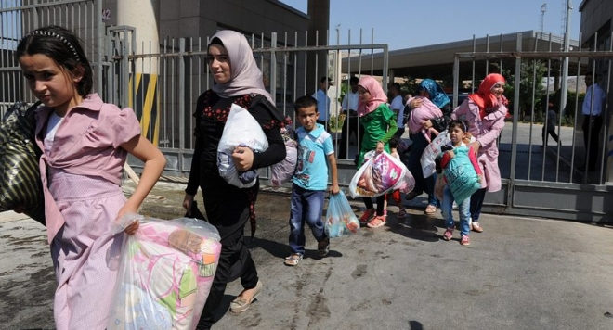

Slide 8
In early November 2013, 1,500 police were deployed to reinforce controls along the Bulgarian-Turkish border in the Elhovo region. Preparations have commenced for the erection of a fence along the border between the villages of Lesovo and Kraynovo.

Slide 9
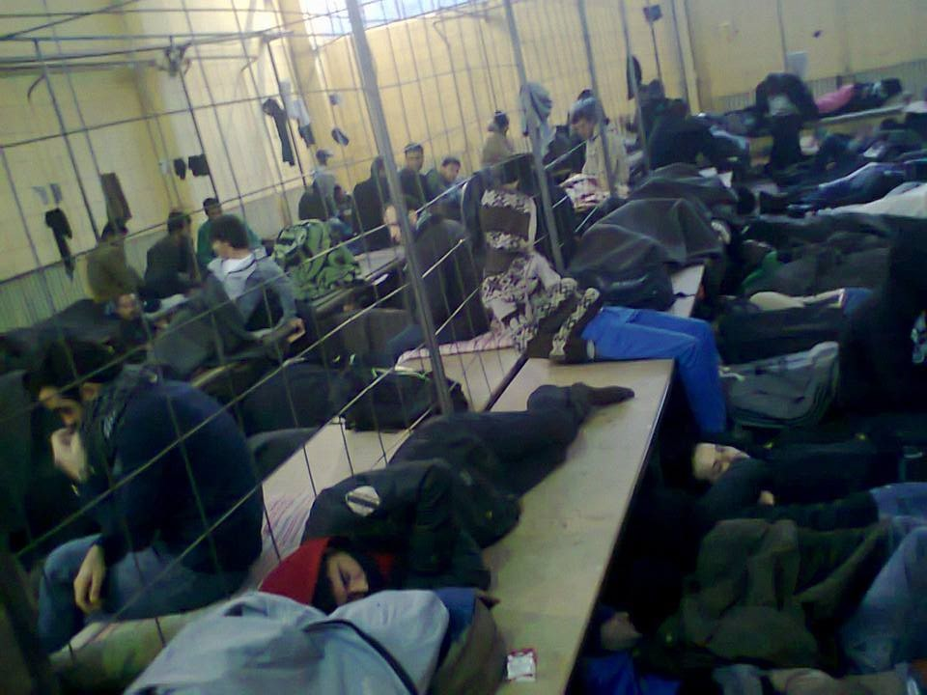

Slide 10
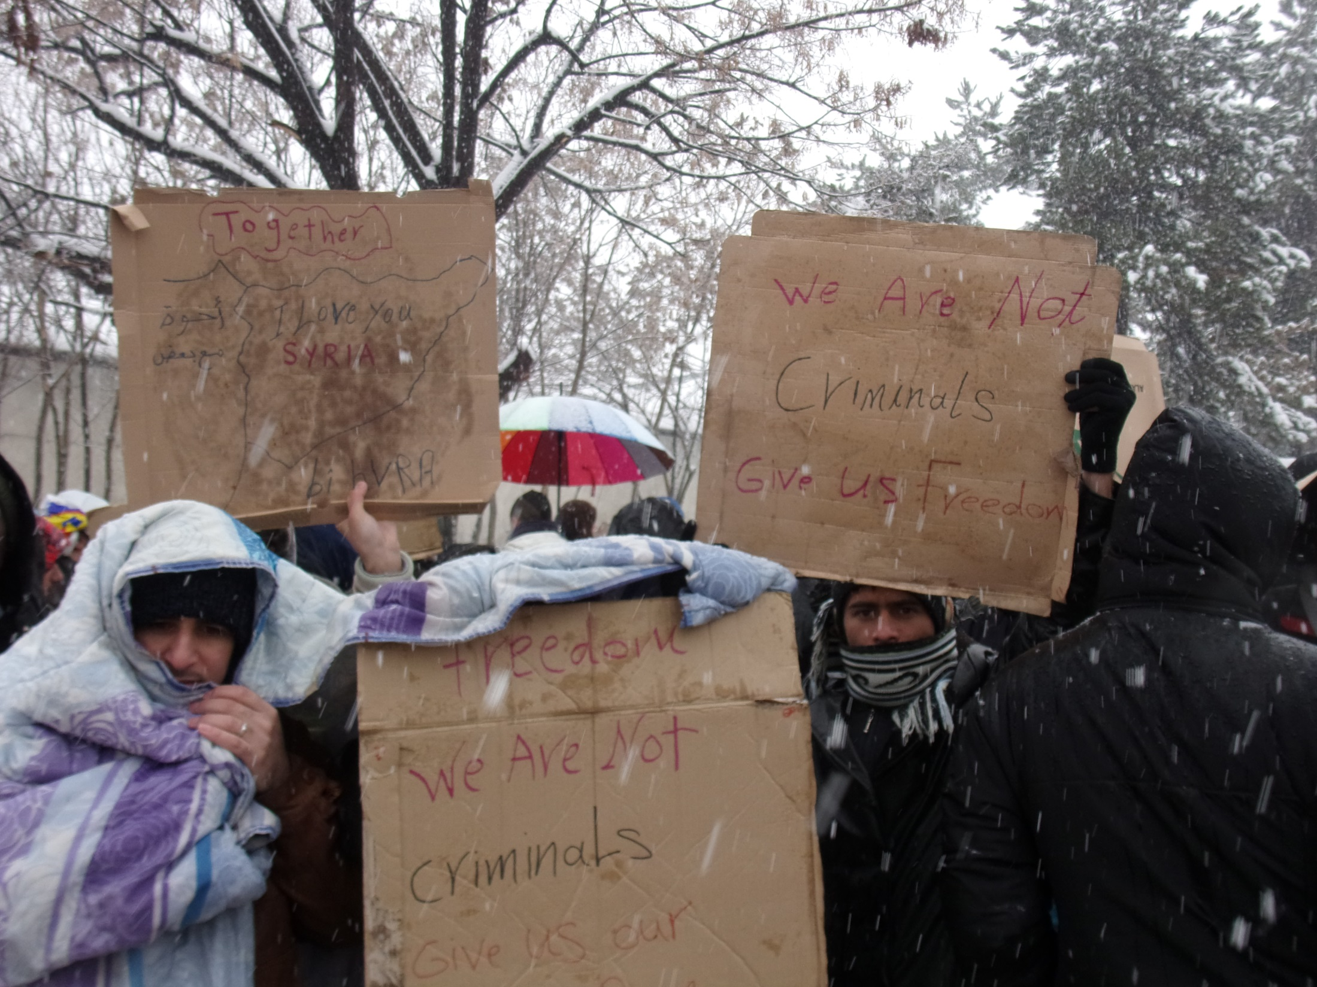

Slide 11
Health services

Slide 12
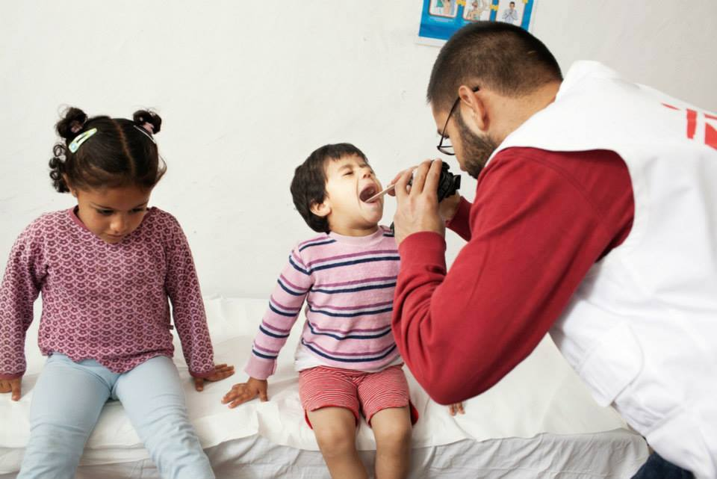

Slide 13
Limitations
Some children are catching fevers and colds, but there is no health clinic in the guarded camp and people lack funds to buy medicine. Serious cases have to be taken to the nearest hospital, but not all those with serious medical problems are getting the help they need.
Social counselling and psychological support is not provided in any of the special centers for accommodation;
Asylum-seekers that live outside the centers have difficulties accessing health care;

Slide 14
Limitations
Routine immunization is a problem, especially for babies and the process needs to be coordinated with the public health system.
Asylum-seekers do not understand the medical system and outreach work is needed;
Once refugees leave the camps, they have to pay their health insurance contributions themselves.

Slide 15
Good Practices
MSF opened medical offices in Harmanly, Vrazdebna and Voenna Rampa to address the urgent medical needs of the accommodated asylum seekers.
UNHCR finances a project run by the Council of Refugee Women for social mediators.
Other NGOs in the country also facilitate this process.

Slide 16
Education

Slide 17
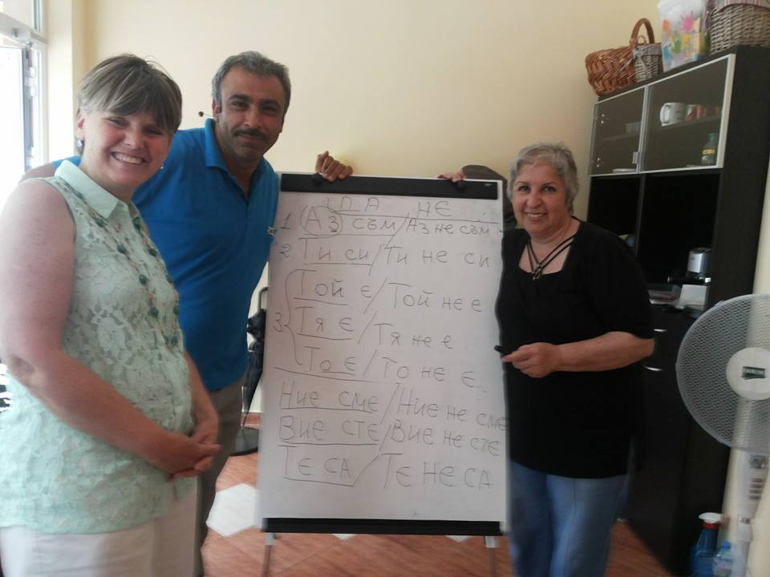

Slide 18
Limitations
There are no organized classes in Bulgarian in the centers; only Caritas, under UNHCR project provides Bulgarian classes (since March 2014);
Most children still do not have access to Bulgarian schools;

Slide 19
Limitations
The law requires children to have a document stating their completed level of education. Most children have no documents with them when they arrive;
The requirement of the Reception Directive that education cannot be postponed by more than 3 months is not being observed.

Slide 20
Good Practices
UNHCR initiated language classes for children, through its implementing partner Caritas (since March 2014);
There are other NGOs in the country that also facilitate this process.
NO other good practices can be noted at this time…

Slide 21
Unaccompanied minors
Bulgaria does not have an effective mechanism for appointment of legal guardians/representatives for the unaccompanied minors seeking asylum.

Slide 22
CHALLENGES AHEAD
No integration program as of June 2014!
Work with unaccompanied minors;
Racism and homophobia among the local population;
Negative reporting about asylum seekers - the BG media needs to stop referring to refugees as "illegal immigrants„.

Slide 23
'I refuse to accept the view that mankind is so tragically bound to the starless midnight of racism and war that the bright daybreak of peace and brotherhood can never become a reality. ... I believe that unarmed truth and unconditional love will have the final word in reality.' Martin Luther King

